Slide 1
Title
Drone Swarm Formations

Slide 2

Overview
Problem: Formation flight in dense environments
Goal: Maintain formation by avoid obstacles

Slide 3
Contributions
A novel differentiable formation, Based on: Graph Laplacians, Measures overall formation shape, Invariant to rotation...
A distributed optimization framework that includes: Formation similarity, Obstacle avoidance, Reciprocal collision avoidance, Dynamic feasibility
Extensive real-world and simulated experiments: Swarm of 7 drones in hexagon formation, Tetrahedron formation in narrow corridor with 4 drones, and heart-shaped formation simulation with 10 drones

Slide 4
Formation Modeling
Drones as nodes in a graph
Edges/link store inter-drone distances
Complete weighted graph
    Node 1 ——5m—— Node 2
    Node 1 ——8m—— Node 3
    Node 2 ——3m—— Node 3

Slide 5
Common methods:
Fully Connected Graph
Neighbor-Based Graph
Formation-Based (Connect drones based on the desired formation pattern)

Slide 6
Why This Metric is New
Captures overall formation shape
Differentiable → used in optimization
Allows shape deformation safely
  Hexagon formation
  Tetrahedron formation through corridor (ormation rotates + compresses adaptively)
  Heart-shaped 10-drone formation

Slide 7
Map + ESDF(Euclidean Signed Distance Field)
Voxel map library
ESDF allows the optimizer to compute:
    distance to nearest obstacle
    gradients for obstacle penalty

Slide 8
Minimum Control Effort Polynomial Trajectories
MINCO is a framework for generating smooth, feasible trajectories for drones.
Position → where you are
Velocity → how fast you're moving
Acceleration → how fast your speed is changing
Jerk → how fast your acceleration is changing

Slide 9
Minimizes multiple cost terms:
Control effort
➢Timing
➢Obstacle avoidance
➢Formation similarity
➢Reciprocal collision avoidance
➢Dynamic feasibility
➢Uniform constraint distribution

Slide 10
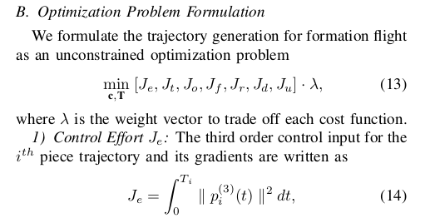

Slide 11
Formation Similarity
Uses the graph Laplacian metric
➢Measures how far the current formation is from the target shape.
➢Penalizes drones if the shape breaks

Slide 12
Cont...
Reciprocal Collision Avoidance(ensures that drones avoid hitting each other)
RVO (Reciprocal Velocity Obstacles)
Predict future positions, detect if their velocity vectors will cause a crash, and compute a safe velocity region
Minimum separation constraints
∥pi​−pj​∥≥dmin​
➢Collision cones
Mathematical method to predict if two drones will collide in the future based on current motion

Slide 13
Drone Swarms in Military
Can quickly map an entire battlefield area
Extending radio range for friendly forces
Border monitoring
• Wide-area surveillance
Low-cost and reduce risk to human soldiers
Spread out to avoid being easily detected
• Confuse or overload enemy sensors

